Slide 1
Basics of SAP and ABAP

Slide 2
Introduction to ERP
E - Enterprise R - Resource P - Planning.
It's purpose is to manage any organization/company functions.
It is a way to integrate the data and processes of an organization into one single system.

Slide 3
Introduction to SAP
S - Systems A - Applications P - Products in Data Processing.
SAP is an ERP product.
SAP introduced by SAP AG in 1972 at Walldorf(Germany).
It is a German based product.

Slide 4
Features of SAP
Integration of all functions
Multi-lingual software
Support multiple currencies
User-based license agreement

Slide 5
Modules of SAP
SAP divided the modules broadly in to 2 categories.
Functional modules
Technical modules

Slide 6
Functional Modules of SAP
SD - Sales & Distribution
MM - Material Management
HR/HCM - Human Resources/Human Capital Management
PP - Production Planning
FICO - Finance & Controlling
WM - Warehouse Management

Slide 7
Technical Modules of SAP
ABAP - Advanced Business Application Programming. It is a programming language for SAP.
BASIS - Business Application Software Integrated Solution. It is for monitoring and administration of SAP systems.
BI - Business Intelligence. It is used to analyze and presents the data in the form of reports, dashboards etc.

Slide 8
Technical Modules of SAP(Contd.)
CRM - Customer Relationship Management
PI - Process Integration

Slide 9
SAP Netweaver
SAP NetWeaver(NW) is an integrated technology platform which can support various SAP applications.
Examples - SAP ERP(Enterprise Resource Planning) , SAP CRM(Customer Relationship Management) , SAP SRM(Supply Relationship Management) , SAP PI(Process Integration) etc.

Slide 10
SAP R/3 Architecture
In SAP R/3 architecture - R stands for Real, 3 stands for 3 layers.
The 3 layers in the architecture are as follows:
Presentation layer
Application layer
Database layer

Slide 11
Presentation Layer
Presentation layer is also called as user interaction layer.
It acts as an interface between end user and SAP system.
It collects user input and creates process request.

Slide 12
Application Layer
It acts as an interface between presentation layer and database layer.
Application layer is responsible for writing the programs and applications.
It uses the application logic of program to collect and process request.

Slide 13
Database Layer
Databases(Oracle, DB2 etc.) reside on the database Layer.
It stores and retrieves the data.

Slide 14
Introduction to ABAP/4
A - Advanced B - Business A - Application P - Programming.
ABAP is a programming language for SAP.
It is a 4th generation Language.
ABAP lies on application layer of SAP.

Slide 15
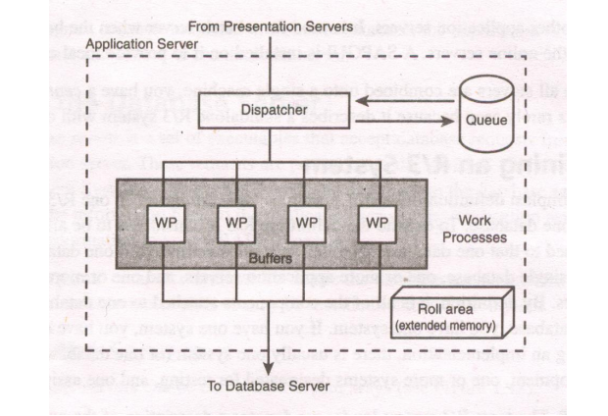
Application Server Architecture
Dispatcher
Work Process
User Context
Roll Area

Slide 16
Dispatcher
All requests that come in from presentation servers are directed first to dispatcher.
The dispatcher writes them first to the dispatcher queue.
The dispatcher pulls the requests from the queue on a first-in, first-out basis.

Slide 17
Work Process
Each request from the dispatcher is then allocated to the first available work process.
A work process handles one request at a time.
A work process needs to address two special memory areas - the user context and the program roll area.

Slide 18
User Context
The user context is a memory area that contains information about the user.
When a user logs on, a user context is allocated for that logon.
When a user log off, it is freed.

Slide 19
Roll Area
Roll area is a memory area that contains information about the program execution .
When a program runs, a roll area is allocated for that program.
The roll area is freed when the program ends.

Slide 20
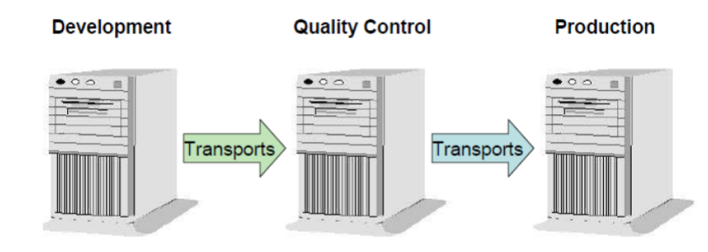
SAP System Landscape
SAP system landscape consists of 3 systems.
Development
Quality
Production

Slide 21
Development
It is used for all developments and configurations.
The developments and configurations move from development system to quality system through a mechanism called as transport request.

Slide 22
Quality
The testing of all the developments and customizations needs be done in the quality system.
The developments and configurations move from quality system to production system through transport request.

Slide 23
Production
It is also called as live system or customer based system.
Customer runs his business through production system.

Slide 24
SAP GUI
G - Graphical U - User I - Interface
It allows end users to use various SAP applications by providing easy to use graphical interface.

Slide 25
Types of SAP GUI
SAP GUI for Windows - SAP GUI for windows is a windows operating system that offers a windows like user experience.
SAP GUI for JAVA - SAP GUI for JAVA environment is written in JAVA and is the platform-independent implementation of SAP GUI.
SAP GUI for HTML - Consist of Internet Transaction Server (ITS) on the server side and a web browser on the client side.

Slide 26
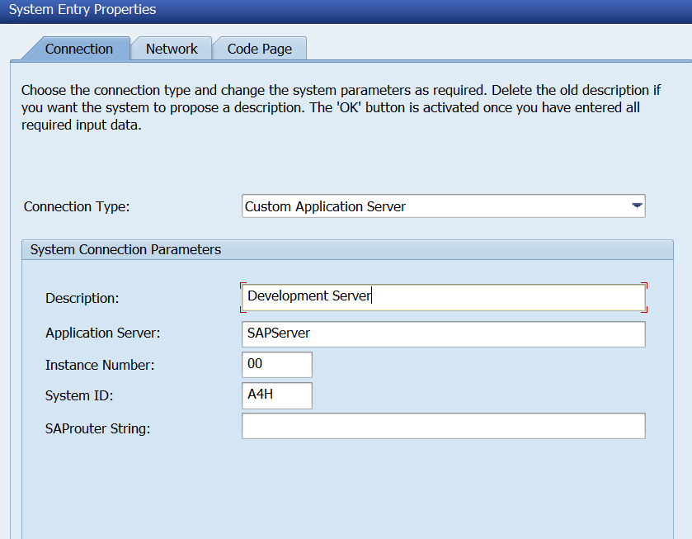
SAP Logon Configuration
Description
Application Server
Instance Number
System ID

Slide 27
Description
Meaningful description of the SAP system.
In case description is not provided, it is a combination of system id and application server.

Slide 28
Application Server
It is the host name or IP address of the server.
Example : Hostname of the server is SAPServer or IP address of the server is XXX.XXX.XX.XX , where X is any number.

Slide 29
Instance Number
It is the instance number of SAP system which is defined during SAP installation.
It is of 2 characters long.
It varies from 00 to 99.

Slide 30
System ID
System ID is a unique identification code for every SAP system which is defined during SAP Installation.
It is of 3 characters long.
Examples - A4H, S4H etc.

Slide 31
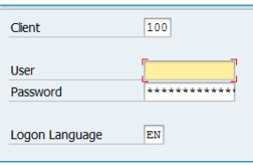
Logging on to SAP
Client
User
Password
Logon Language

Slide 32
Client
This is the client number of SAP system which appears in the client field on the logon screen.

Slide 33
User
As SAP is a user-based license agreement, valid credentials are required to logging on to SAP.
Enter the user id provided by the administrator.

Slide 34
Password
Enter the default password provided by the administrator for the first time login.
After entering the default password, system prompts for the new password and confirm password
Next time, login with the new password.

Slide 35
Language
As SAP is multi-lingual software, one needs to provide the logon language.
By default, one language appears, one can change the logon language depends upon the requirement.

Slide 36
Features of SAP GUI
A single face GUI for accessing all SAP applications such as ERP(Enterprise resource planning), CRM(Customer Relationship Management), SAP SRM(Supply Relationship Management), PI(Process Integration) etc.
Users are allowed to login with their preferred language, as the same GUI can be used in different languages.

Slide 37
Features of SAP GUI(Contd.)
It contains user parameters that are defined for more frequently keyed inputs. This enables the automatic population of text , based on specific user logins. This in result, reduces the percentage of user inputs in real time.
SAP GUI allows to configure GUI font size, colors, logos, custom layouts etc.

Slide 38
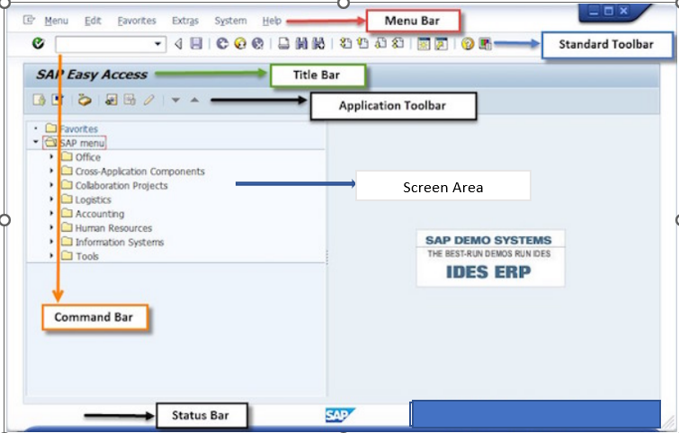
Elements of SAP GUI(Parts of SAP GUI)
Menu Bar
Standard Toolbar(Function Keys)
Command Bar
Title Bar
Application Toolbar
Screen Area
Status Bar

Slide 39
Menu Bar
The menu bar appears on the top of every SAP screen.
The menu bar changes from screen to screen.
System and help menus are always available on every screen.

Slide 40
Standard Toolbar
The standard toolbar is located below the menu bar.
The standard toolbar buttons are also called as function keys.

Slide 41
Command Bar
Command bar is used to enter the transaction codes.
Command bar can be opened and closed by using the icon on the right of the command bar.

Slide 42
Title Bar
In between the standard toolbar and the application toolbar lies the title bar.
It is used to display the name of the screen or application you are accessing.
Title bar is dynamic and changes from application to application.

Slide 43
Application Toolbar
The application toolbar is located directly below the title bar.
It contains buttons that duplicate functions available from the menu bar, but provides quicker access to some of the most commonly used functions for the current screen.
The buttons available in the application toolbar changes from application to application

Slide 44
Screen Area
The screen area of SAP GUI is the area where the actual application is displayed.
It consists of layout elements like - buttons, input fields, radio buttons, checkboxes etc.

Slide 45
Status Bar
The status bar is located at the bottom of the SAP screen.
It displays important messages such as errors and completion of transactions.
It also displays the session information also such as system, client, user, program, transaction etc.

Slide 46
SAP Easy Access
After logging in to SAP system through GUI, the first screen that appears on system is SAP Easy Access.
It is a user specific point of entry.
It is also called as SAP User Menu.
The user menu contains only those items that are required to perform daily tasks such as transactions, reports etc.

Slide 47
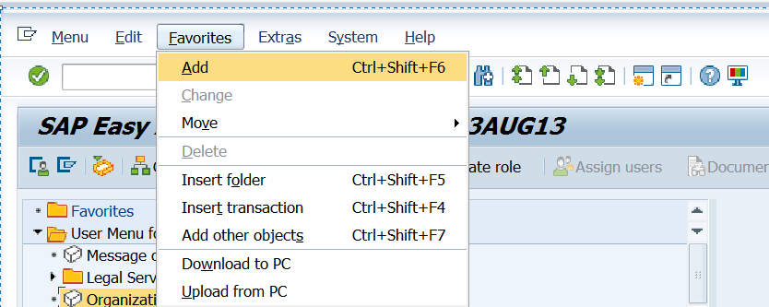
SAP Easy Access - Adding Existing Item as Favorite
Choose the existing item from the User Menu.
Click on Favorites - Add

Slide 48
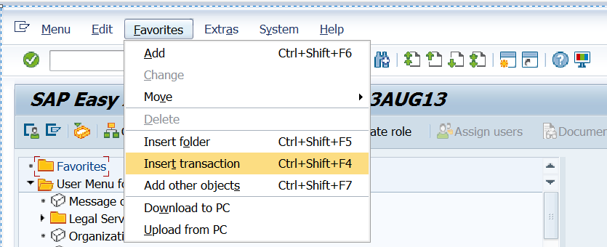
SAP Easy Access - Adding New Item as Favorite
Click on Favorites - Insert transaction

Slide 49
ABAP Workbench
ABAP workbench is a collection of ABAP tools.
Examples : ABAP Dictionary , ABAP Editor , Function Builder , Class Builder etc.
One can access the ABAP workbench tools through transaction code.

Slide 50
Transaction Code
Transaction Code is a shortcut to access the ABAP workbench tools(different applications) in SAP.
Examples : SE11 - ABAP Dictionary , SE38 - ABAP Editor , SE37 - Function Builder , SE24 - Class Builder etc.

Slide 51
Transaction Code(Contd.)
/nxxxx - To call transaction xxxx( override the existing session)
/oxxxx - To call transaction xxxx in a new session
/n - To cancel a session
/o - Display on overview of sessions
Imp point : A user can open a maximum of 6 sessions.

Slide 52
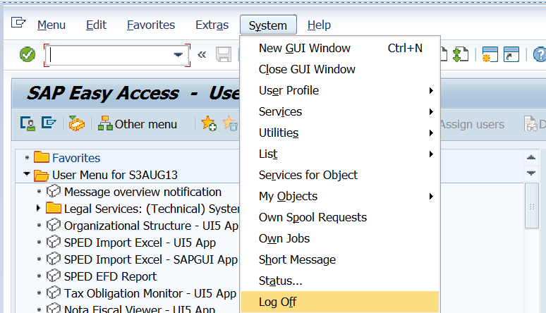
Log Off From SAP System
System - Logoff
Transaction Code - /nend
Transaction Code - /nex

Slide 53
Difference Between /nend & /nex
/nend - Before log off , one confirmation pop-up appears.
/nex - Log off from SAP without confirmation pop-up.

Slide 54
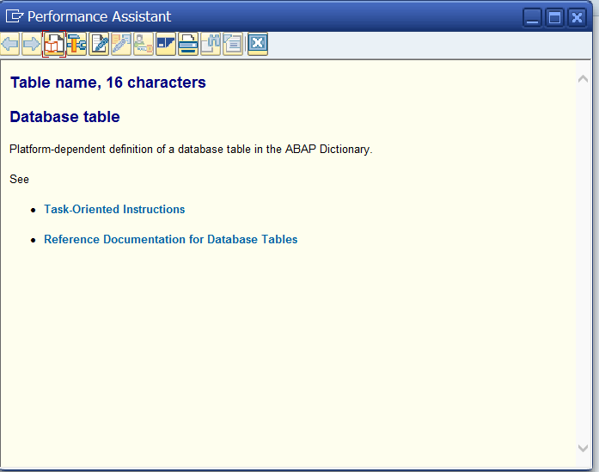
F1 Help in SAP
F1 help is also called as technical information
help.
It provides the technical Information of any
field/column.
To get the technical help of any field, press F1
on that particular field.

Slide 55
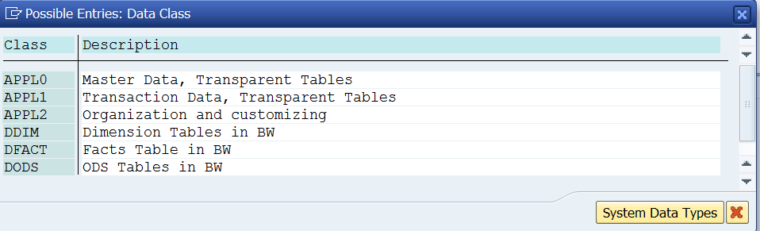
F4 Help in SAP
F4 help is also called as value help.
It provides the various possible values
any field/column.
To get the possible inputs for any field,
press F4 on that particular field.

Slide 56
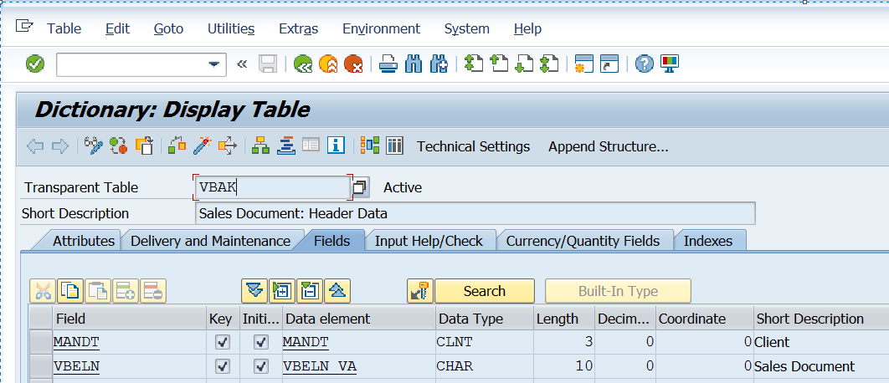
Identifying SAP Objects
SAP Specific objects name starts with
other than Z or Y.
In the example shown - the table
name is VBAK , which is not starting
with Z or Y.

Slide 57
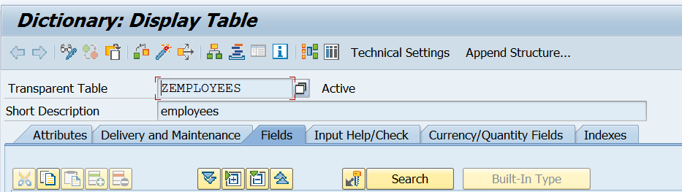
Identifying Customizing Objects
Customizing objects name start with
Z or Y.
In the example shown - the table name
is ZEMPLOYEES , which is starting
with Z.

Slide 58
Concept of Header and Item Information in SAP
In every business process, header and item information plays an important role.
Header information is the information applicable to whole document.
Item information is applicable to specific line of a document.
Header information stores in to header tables.
Item information stores in to item tables.

Slide 59
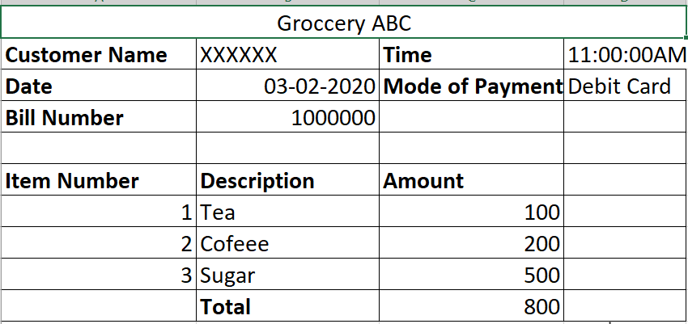
Concept of Header and Item Information in SAP
In the example - header information is
customer name, time, date, mode of
payment, bill number.
The item information is item number,
description and amount.

Slide 60
SAP Standard Tables and Transaction Codes
SAP provided the standard transaction codes to perform the various business process.
The data for that particular business process is getting stored in to SAP standard tables.
Example - To create a sales order, the standard transaction code is VA01 and the data stores in to VBAK(Sales document header) & VBAP(Sales document item) tables.

Slide 61
SAP Standard Tables and Transaction Codes - MM Module
Transaction code to create material - MM01
Transaction code to change material - MM02
Transaction code to display material - MM03
Tables - MARA(Material data), MAKT(Material description), MARC(Plant data for material).

Slide 62
SAP Standard Tables and Transaction Codes - SD Module
Transaction code to create sales order - VA01
Transaction code to change sales order - VA02
Transaction code to display sales order - VA03
Tables - VBAK(Sales document header), VBAP(Sales document item)

Slide 63
SAP Standard Tables and Transaction Codes - SD Module
Transaction code for billing document creation - VF01
Transaction code for billing document change - VF02
Transaction code for billing document display - VF03
Tables - VBRK(Billing document header), VBRP(Billing document item)

Slide 64
SAP Standard Tables and Transaction Codes - FICO Module
Transaction code to create accounting document - FB01
Transaction code to change accounting document - FB02
Transaction code to display accounting document - FB03
Tables - BKPF(Accounting document header), BSEG(Accounting document item)

Slide 65
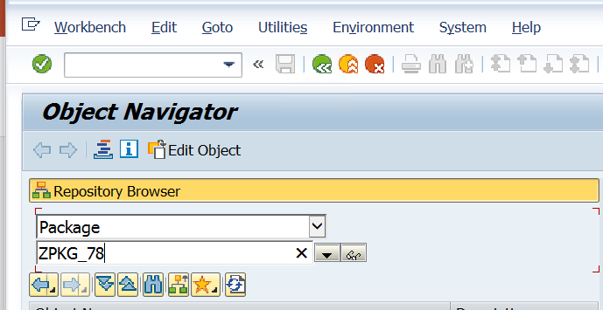
Concept of Object Navigator
The object navigator is a central point of
entry to the ABAP workbench.
One can navigate to any workbench
object through object navigator.
The transaction code for object navigator
is SE80.

Slide 66
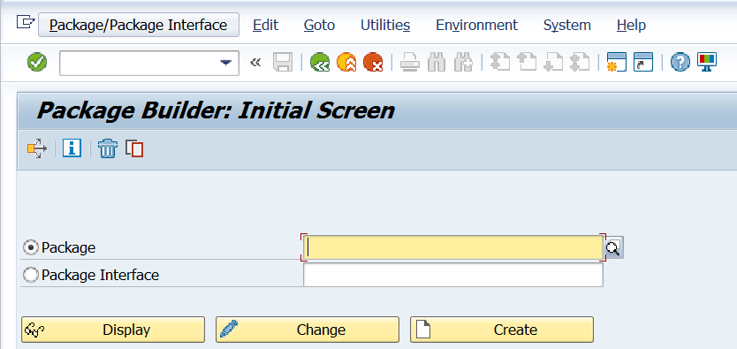
Concept of Package
In SAP, every object stored in to a
package.
A package is a container for the objects
like tables, structures, programs etc.
The package for local objects is $TMP.
The transaction code to create a package
is SE21.

Slide 67
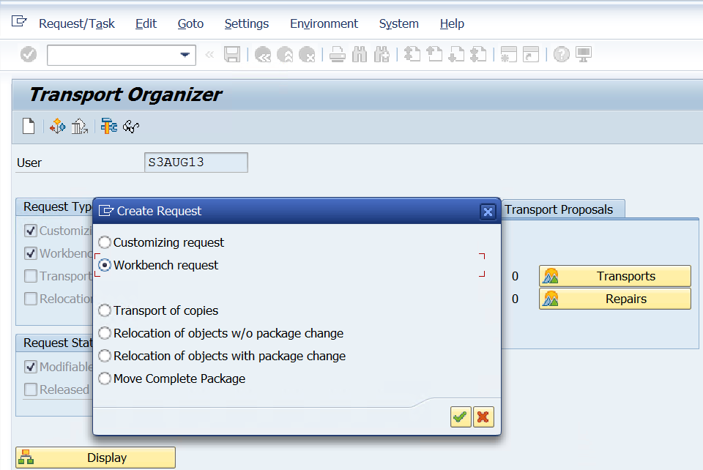
Concept of Transport Request
Transport request is a mechanism to
transport the objects from one system to
another system.
Local objects can never be transported.
To transport the workbench objects,
one needs to create a workbench request.
The transaction code to create a transport request is SE09.

Slide 68
Types of Projects in SAP
There are 4 types of projects in SAP.
Implementation
Support
Upgrade
Roll out

Slide 69
Types of Projects in SAP
Implementation - In these types of projects, Customer is implementing SAP for the first time. All Legacy system data needs to be migrated to the SAP system.
Support - It is also called as Maintenance project. Customer is running his business through SAP. Customer requires support for the daily issues, tickets, and new change requests (CR).

Slide 70
Types of Projects in SAP(Contd.)
Upgrade: In this type of project, customer is moving from older version of SAP to higher version of SAP.
Roll out: In this type of project, the existing SAP system is going to implement for different countries/region.

Slide 71
RICEFW
The another name for RICEFW is WRICEF.
SAP technical objects are divided in to 6 different categories.
R - Reports , I - Interfaces , C - Conversion , E - Enhancements , F - Forms , W - Workflow
When the business requirement cannot be fulfilled by standard SAP functionalities, then we require a RICEFW.
The requirements which cannot be satisfied by standard SAP application are called gaps.
Based on the category of the gap, objects are created in the form of a RICEFW item.

Slide 72
R - Reports
Reports are used to display of information in the required format.
If the business requirement cannot be fulfilled by standard SAP reports, then we develop custom reports based upon the customer requirement.
The various report formats are classical reports, ALV reports etc.

Slide 73
I - Interfaces
Interfaces are used to transfer the data from Non-SAP to SAP , SAP to Non-SAP, SAP to SAP.
The various cross applications like BAPI, RFC, IDOC’s are the example of interfaces.

Slide 74
C - Conversion
The process of converting data from one form to another is called as conversion.
When the customer is implementing SAP for the first time, all Legacy system(Non-SAP) system data needs to be migrated to the SAP system.
To upload the data in the SAP system the data needs to be converted from one form to another as per the system requirement.
After conversion, the data is uploaded into the SAP system by making use of the various data migration tools or techniques like BDC, LSMW, BAPI etc.

Slide 75
E - Enhancements
The process of adding our own functionality to SAP standard functionality is called as enhancements.
If the business requirement cannot be satisfied by standard SAP functionality, then we add our own functionality to the SAP standard functionality.
The various enhancements techniques are - Implicit and explicit enhancements, customer exit, BADI etc.

Slide 76
F - Forms
Forms are layouts in SAP.
If the business requirement cannot be satisfied by standard layouts, then we create our own custom layouts.
We design layouts in SAP by using the various tools like smartforms, adobe forms(PDF forms), SAP Scripts.

Slide 77
W - Workflow
Workflow is the flowing of data from one level to another level.
At every level, one or more actions are required.
Example - When we apply leave in the system, it goes in to workflow of our supervisor to approve or reject that leave.
If the business requirement cannot be satisfied by SAP standard workflow, then it results into creation of custom workflow.

Slide 78
Comparison of ECC , SOH and S4H Systems
Refer to the attached sheet for the detailed comparison of ECC , SOH and S4H systems.

Slide 79
Thank You

